Slide 1
Behavior Driven Development & Test Driven Development
Trainer: Thanh Vo

Slide 2
Warm up - Introductions
Your role
Your background, experiences in the subject
What do you want from this course

Slide 3
Course Objectives
At the end of the course, you will have acquired sufficient knowledge to:
Create test cases with Behavior Driven Development (BDD) & Test Driven Development (TDD).
Create test cases with Behavior Driven Development & Test Driven Development in Integrated Testing Solution automation tool (ITS).

Slide 4
Agenda
Behavior Driven Development (BDD)
Practice BDD with Integrated Testing Solution automation tool (ITS)
Practice TDD with Integrated Testing Solution automation tool (ITS)
Test Driven Development (TDD)

Slide 5
Course Audience and Prerequisite
The course is for Developers and Testers
The following course is prerequisites to this course:
User Stories With Agile Requirement.

Slide 6
Assessment Disciplines
In order to complete the course you must:
Sign in the Class Attendance Class
Class Participation: 70%
Final Exam: 30%
Passing Scores: 70%
Provide your feedback in the End of Course Evaluation

Slide 7
Course Duration
Course Duration: 06 hours
Theory: 3 hours
Break for each part: 10 minutes
Practice: 3 hours

Slide 8
Prologue

Slide 9



Bookshelf Building
Constructors
Bookshelf

Slide 10





Bookshelf Building
Buy
Material/Tools
Measure
Drill
Holes
Fit
Plugs
Combine

Slide 11

Bookshelf Building

Slide 12
Bookshelf Building
Drill hole
Fit plug
Combine
Buy tool,
Measure

Slide 13
Bookshelf Building
Drill hole
Fit plug
Combine
Buy tool,
Measure

Slide 14
Bookshelf Building
Refactor
Pass
Fail

Slide 15
Bookshelf Building
US1: As a house host, I want the bookshelf is level so that I can put some stuff on it.
Notes:
Behaviour ~ Status (shelf is passive)

Slide 16
Bookshelf Building
US1: As a house host, I want the bookshelf is level so that I can put some stuff on it.
Scenario 1: put a level measure on the bookshelf then check.
Notes:
Behaviour ~ Status (shelf is passive)

Slide 17



Bookshelf Building
As a house host, I want the bookshelf is level so that I can put some stuff on it.
Testcase 1: put a box on the bookshelf then check.
Testcase 2: put a ball on the bookshelf then check.
Testcase 3: put a bubble level on the bookshelf then check.
Notes:
Behaviour ~ Status (shelf is passive)

Slide 18
Bookshelf Building
Write a test for the feature with failed result
Refactor
Pass
Fail

Slide 19
Behavior Driven Development (BDD)

Slide 20
What is BDD ?
Behavior Driven Development (BDD): is a software development process for teams to create simple scenarios on how an application should behave from the end user's perspective.

Slide 21
BDD focuses on:
What to test and what not to test
How much to test
What to call the tests
How to understand why a test fails

Slide 22
Principles of BDD
BDD encourages simple languages to be used across teams.
The simple and easy to use language, a business person can read a test and understand what it is testing.
Tests are written from the customer’s view.

Slide 23
Benefits of BDD
Simple language – the straightforward language is usable/understandable.
Focus – BDD helps teams focus on a product’s behavioral elements
Using Scenarios – BDD is designed to speed up the development process. Everyone involved in development relies upon the same scenarios. Scenarios are requirements, acceptance criteria, test cases, and test scripts all in one.
Efficiency – BDD frameworks make it easy to turn scenarios into automated tests.

Slide 24
How to write BDD scenarios
A BDD scenario is a written description of your product’s behavior.
People in-charge: Business Analyst (BA), Tester (QC).
Using these keywords to describe BDD scenario
Pre-Condition (Given)
Action (When)
Expected Results (Then)

Slide 25
Practice BDD with Integrated Testing Solution (ITS)

Slide 26
User story
A very high-level definition of a requirement.
User story format:
As a [user role], I need/want [the ability to something], so that I can [get some benefit or avoid some consequence].
User story sample: As a GitHub user, I want to access My Profile.

Slide 27
BDD scenarios
Scenario #1: User login successfully and access profile.
Pre-Condition: User login successfully.
Action: click on avatar icon.
and click on Your profile option.
Expected Results: the page redirects to profile page.
and user’s name is displayed.
and user’s avatar is displayed

Slide 28
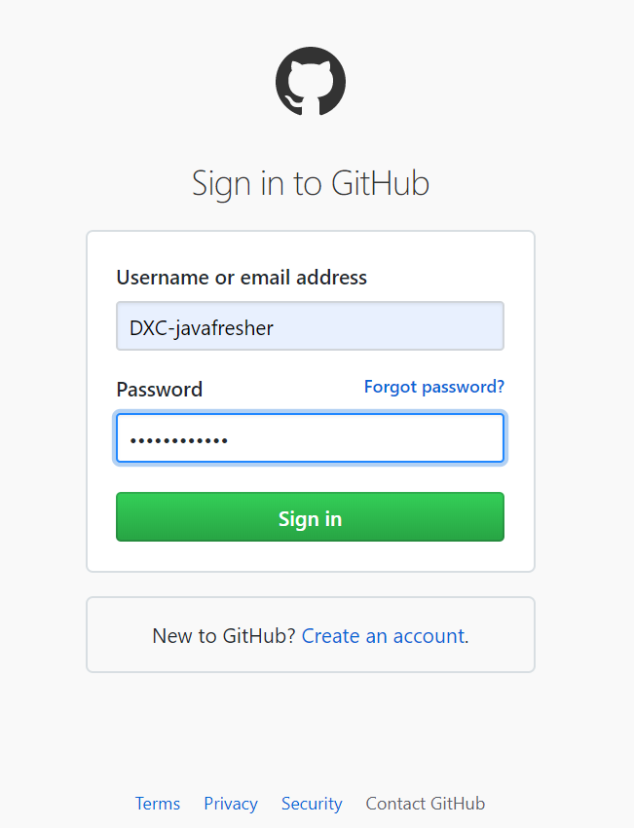
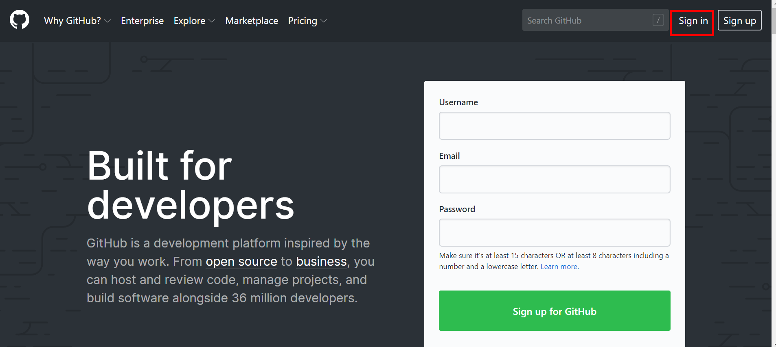
Scenario 1 – Pre-condition
1
2
3

Slide 29
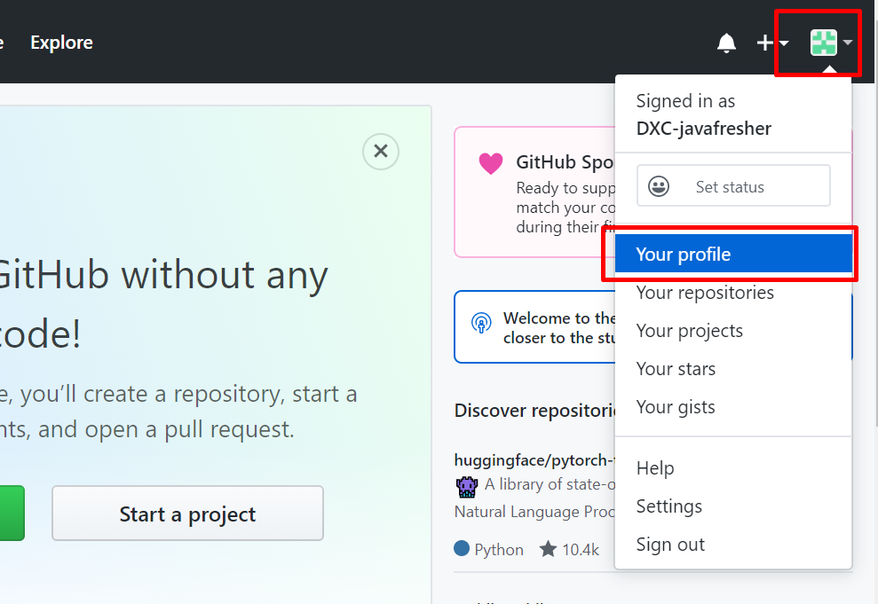
Scenario 1 – Action
1
2

Slide 30
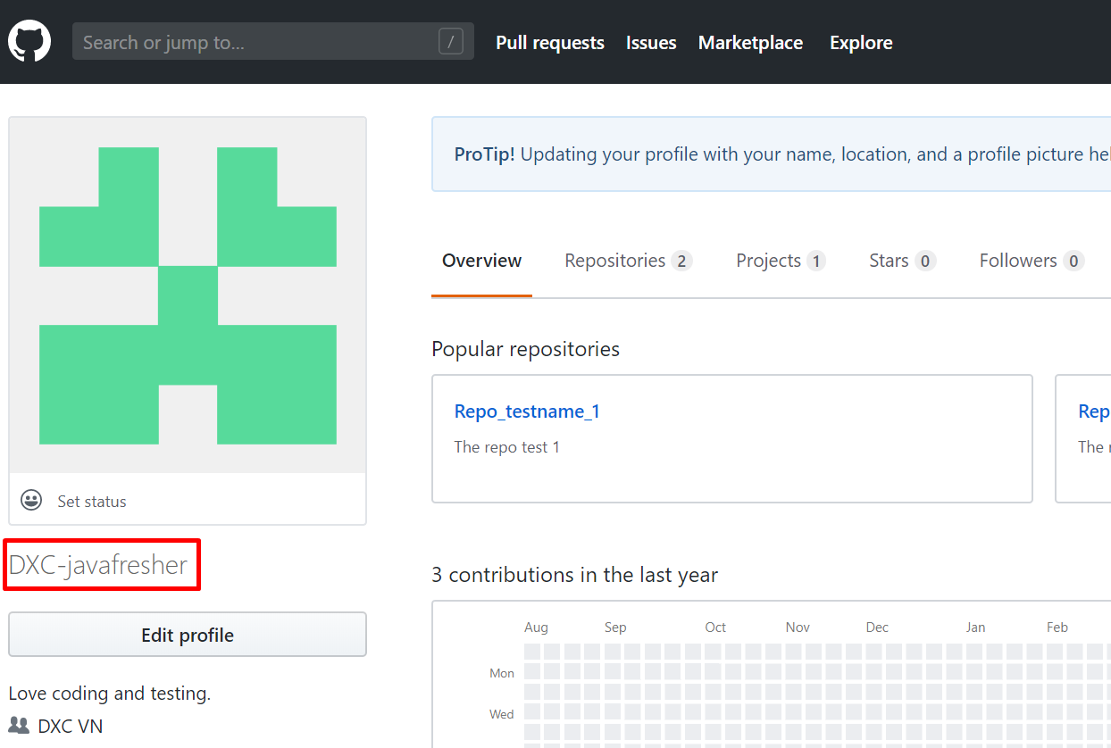
Scenario 1 – Expected result
1
2

Slide 31
BDD scenarios
Scenario #2: User login successfully and check the list of repositories.
Pre-Condition: User login successfully.
Action: click on avatar icon.
and click on Your profile option.
and click on Repositories tab.
Expected Results: the page displays the list of repositories’ names with their descriptions.

Slide 32
BDD scenarios
Username: DXC-javafresher.
Password: ilovedxc1908

Slide 33
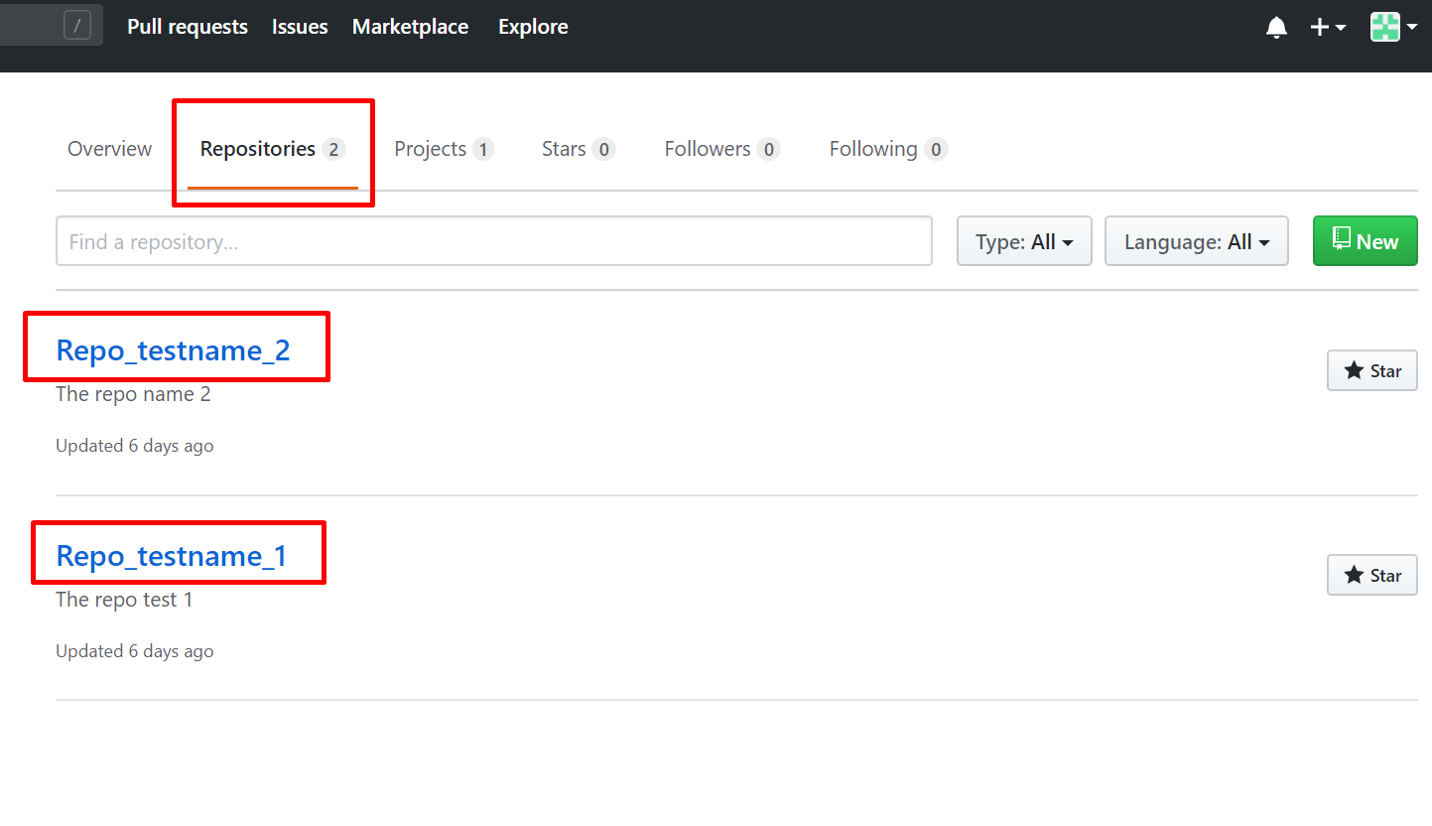
Scenario 2 – Expected Result
1
2
3

Slide 34


About ITS
ITS - stand for Integrated Transformation Solution – is a web-server application used for testing web-based or mobile applications.
By transforming the natural language to the script execution, the developers is not only able to write the test cases in the coherent and transparent way, but also easily readable with people who are not in developing team.
ITS
Integrated Transformation
Solution

Slide 35
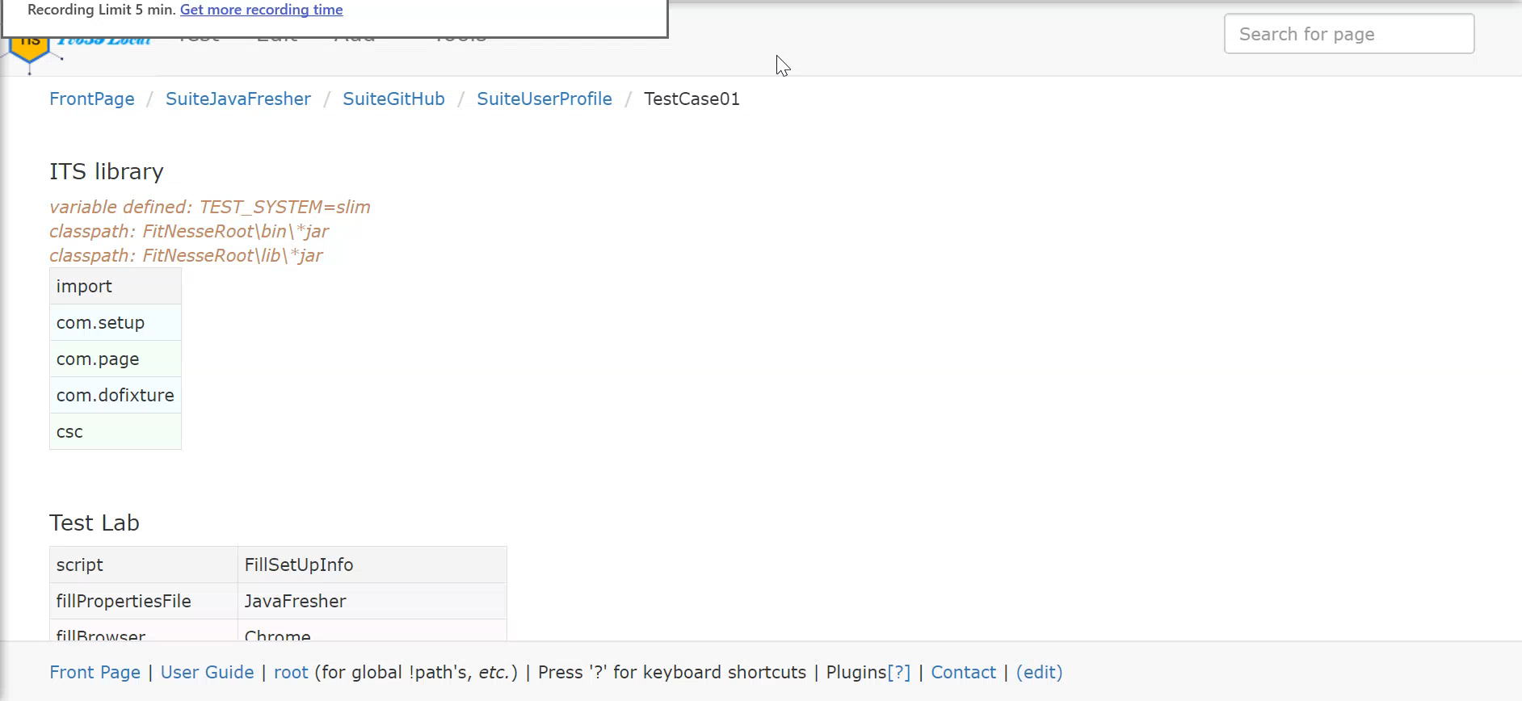
Scenario 1 – Implement with ITS

Slide 36
ITS Structure
Test Plan
Test Group
User Story
Test Case

Slide 37
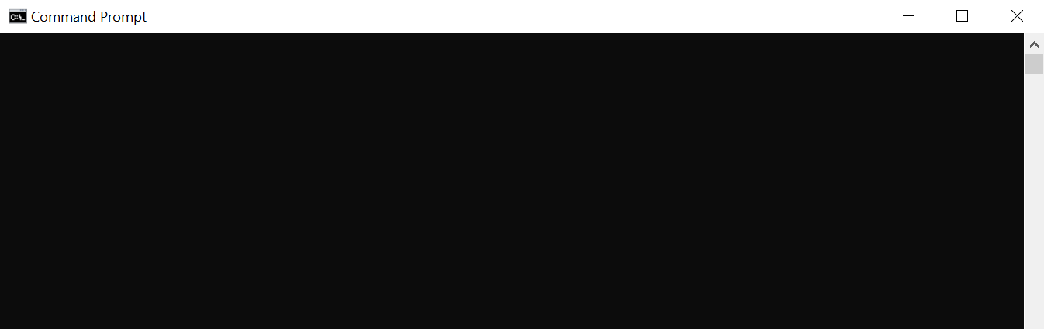
Start up ITS
1/ Open ITS directory: D:\ITS
2/ Open Command Windows Prompt at the folder directory
3/ Type command line: java –jar its.jar -p <ITS port number>

Slide 38
Start up Selenium
1/ Open ITS directory: D:\ITS\selenium
2/ Open Command Windows Prompt at the folder directory
3/ Type command line: java –jar <selenium.jar> -port <selenium port number>

Slide 39
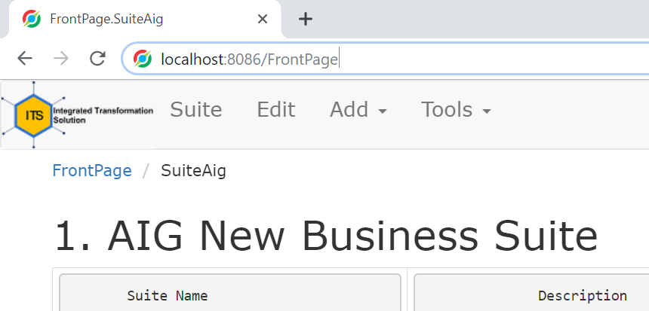
Go to FrontPage
Open browser. In address bar, type: localhost:<ITS port number>/FrontPage

Slide 40
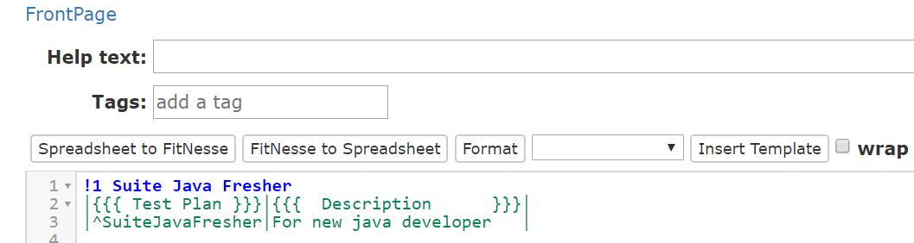
Create Test Plan
1/ Click Edit button
2/ Type the script into editor (as the picture) to create Test Plan
3/ Click Save button
1
2
3

Slide 41
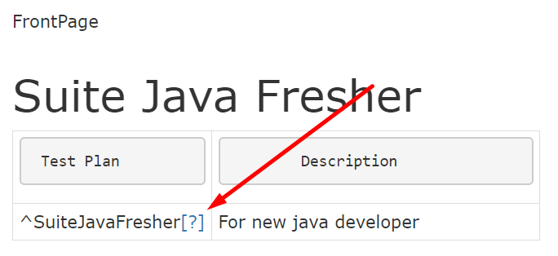
Create Test Group
1/ Click [?] button next to your Test Plan name

Slide 42
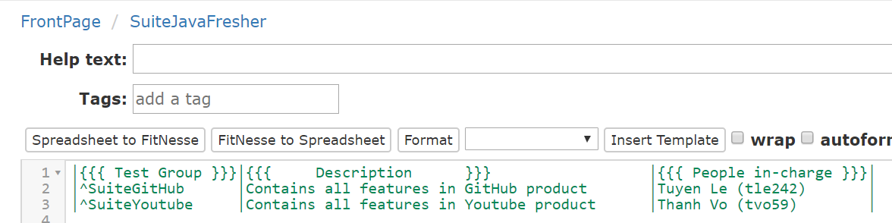
Create Test Group
2/ Type the script into editor (as the picture) to create Test Group
3/ Click Save button
2
3

Slide 43
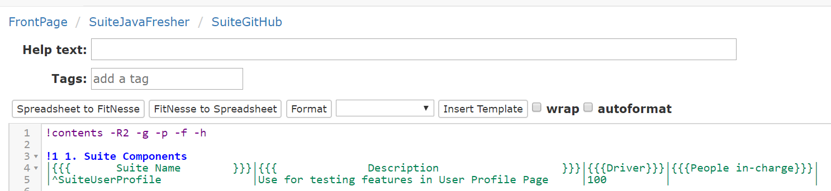
Create Sub-Test Group
Repeat the steps in Create Test Group
2
3

Slide 44
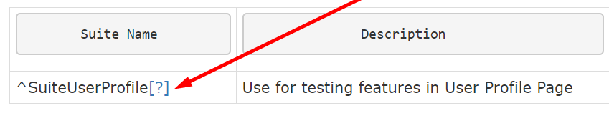
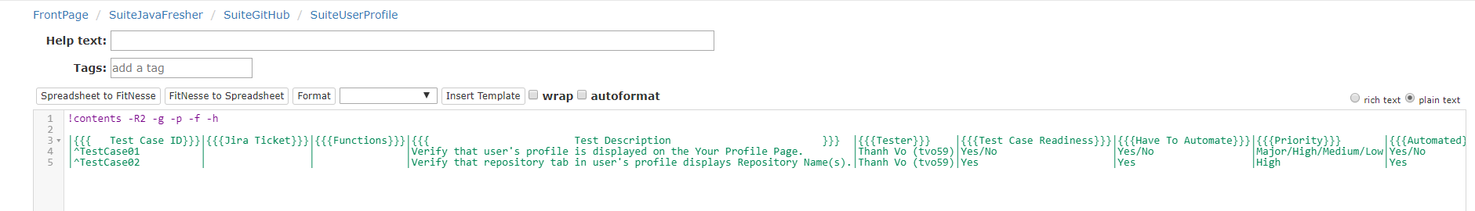
Create Test Case
1/ Click [?] button next to your Test Group or Sub-Test Group name
2/ Type the script into editor (as the picture) to create Test Case
3/ Click Save button

Slide 45
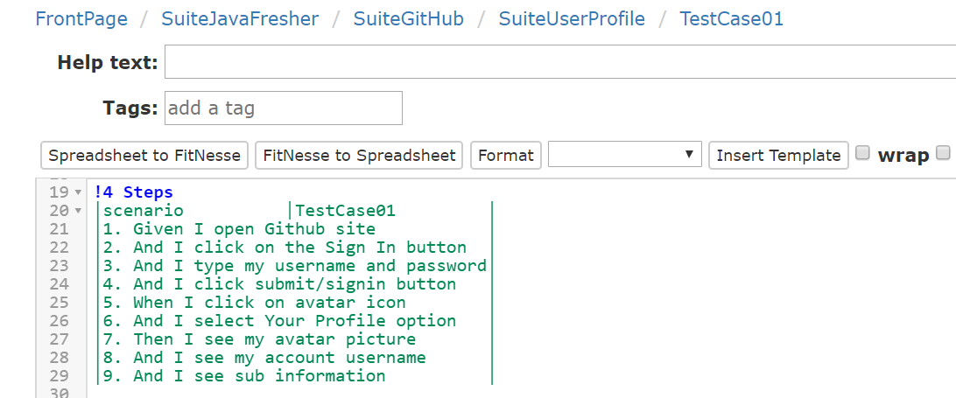
Create Steps in Test Case

Slide 46
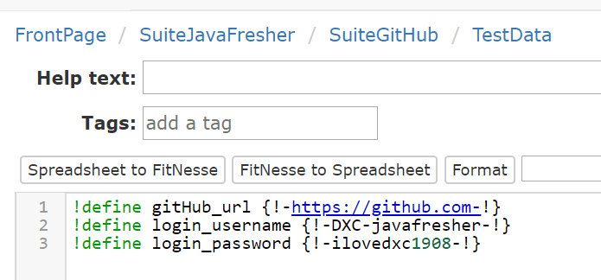
Create Test Data

Slide 47
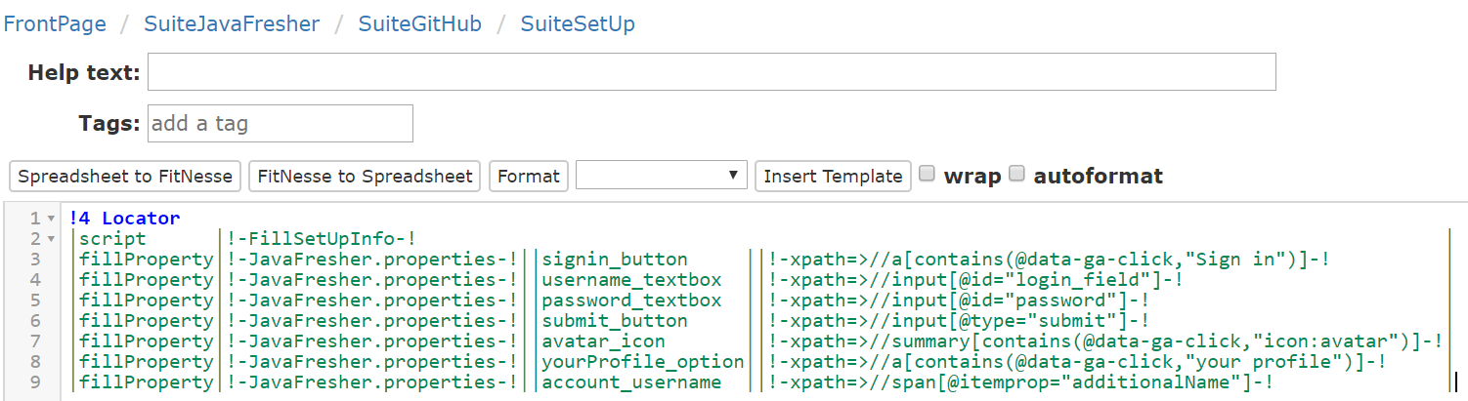
Create Test Data

Slide 48
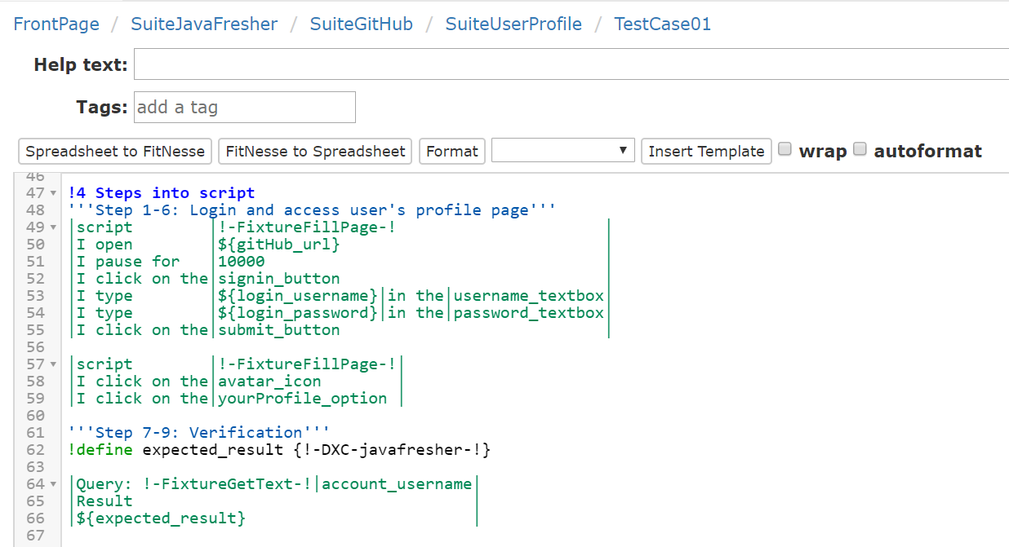
Create Runnable Script based on Test Steps

Slide 49
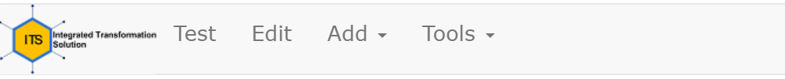
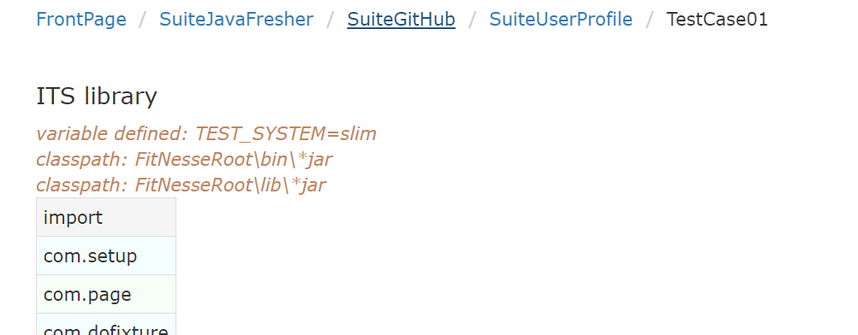
Execute Test Case

Slide 50
Execute Test Case
Result:
1/ Passed all verification steps (Expected result = Actual result)
2/ Failed at least 01 of verification steps (Expected result ≠ Actual result)
3/ Failed due to object(s) not found or stop testing

Slide 51
Exercise #1
Use ITS tool to create automation test case as the Test Design below:
No. | Steps in detail | Data | Expected result
Pre-condition: There is a repository on Github with named in the format: [Your name]_[Your seat number]_fresher Example: ThanhVo_00_fresher.
1 | Login to Github | Username: DXC-javafresher Password: ilovedxc1908 | Successfully login and be redirected to Github’s landing page
2 | Go to profile page by clicking avatar icon and choose Your profile |  | Redirect to profile page
3 | Click on Repository Tab
4 | Verify your repository’s name |  | The repository’s name is correct as the format in Pre-condition

Slide 52
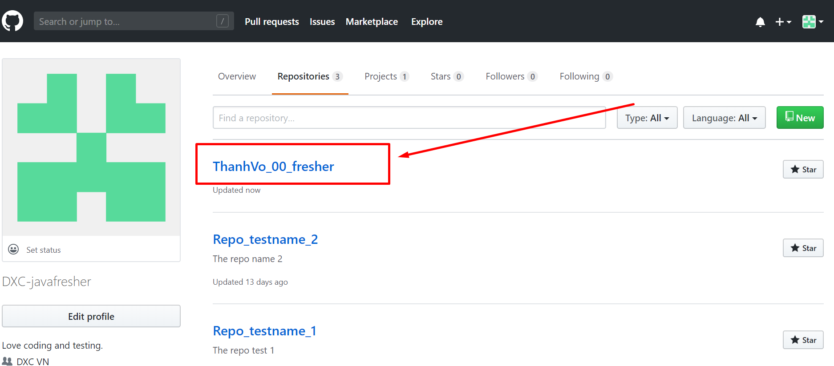
Exercise #1

Slide 53
Test Driven Development (TDD)

Slide 54
What is TDD ?
Test Driven Development (TDD): is software development process in which developers first write the unit tests for feature or module based on requirements and then implement the feature or module itself.

Slide 55
Benefits of TDD
Short debugging time / effort: When a unit test fails, will know exactly what specifically has failed
Safety money: tests become a safety money for the team
Less bugs: more unit tests can often reduce the number of defects

Slide 56
TDD Process
People in-charge: Developers, Programmers, Technical Architect (TA)
1.
Add a test
2.
Run tests and see new failure
3.
Write code
4.
Run tests see all pass
5.
Refactor

Slide 57
5 steps to make TDD and unit testing easy
Step 1: Add a test: Analyze task and implement unit test
Step 2: Run all tests to see new failure
Step 3: Implement function by coding
Step 4: Execute test and see all pass
Step 5: Refactor

Slide 58
Several stages and principles to be followed in TDD
All tests are written before the code
Write a test
Run all tests to check that the new test fails
Write the code
Re-run the tests
Refactor the code if necessary
Re-run the tests

Slide 59
Practice TDD Web development with ITS

Slide 60
User story
User story summary: Show referral remark (referral reason) when creating a quotation triggered the rule of Year of Construction.

Slide 61
Task
Implement the function to filter policy transactions triggering below rules :
If Year of Construction > 1930 → the status of quotation is Quoted

Slide 62
Step 1 Creating unit test first
Use ITS tool to create unit test:
No. | Steps in detail | Data |  | Expected result
Pre-condition: There is a quotation with status Referral Required and trigger the rule of Year of construction.
1 | Open the link of quote in Pre-condition and login to AIG site | Username: tvo59@dxc.com Password: P@ssword123 | Username: tvo59@dxc.com Password: P@ssword123 | Successfully login and be redirected to Transaction Policy’s page
2 | Verify the remark attached under the status |  |  | Remark message content: “Referral triggered due to Year of Construction”

Slide 63
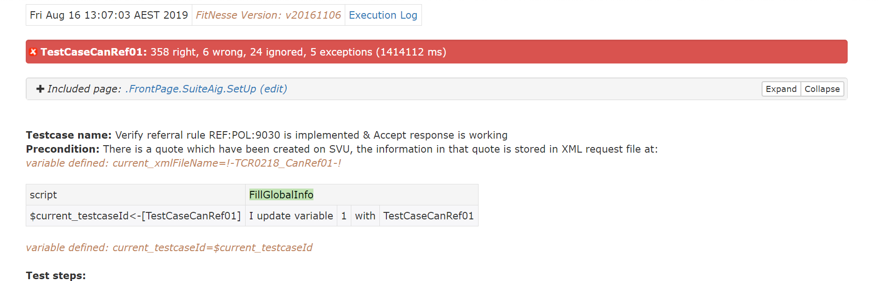
Step 2 Run to see failure

Slide 64
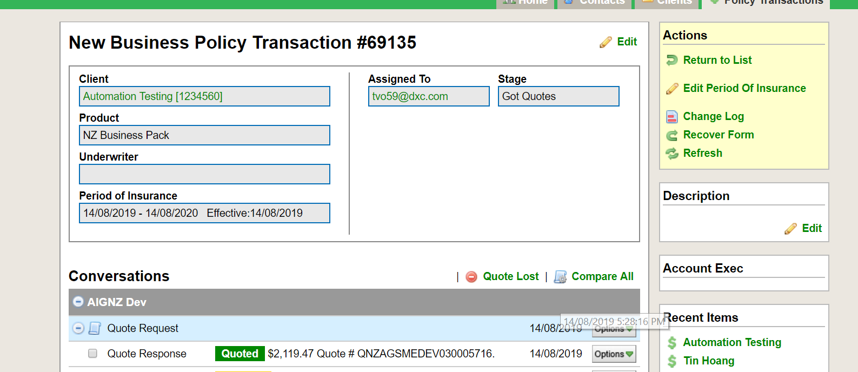
Step 3 Write code to implement the function

Slide 65
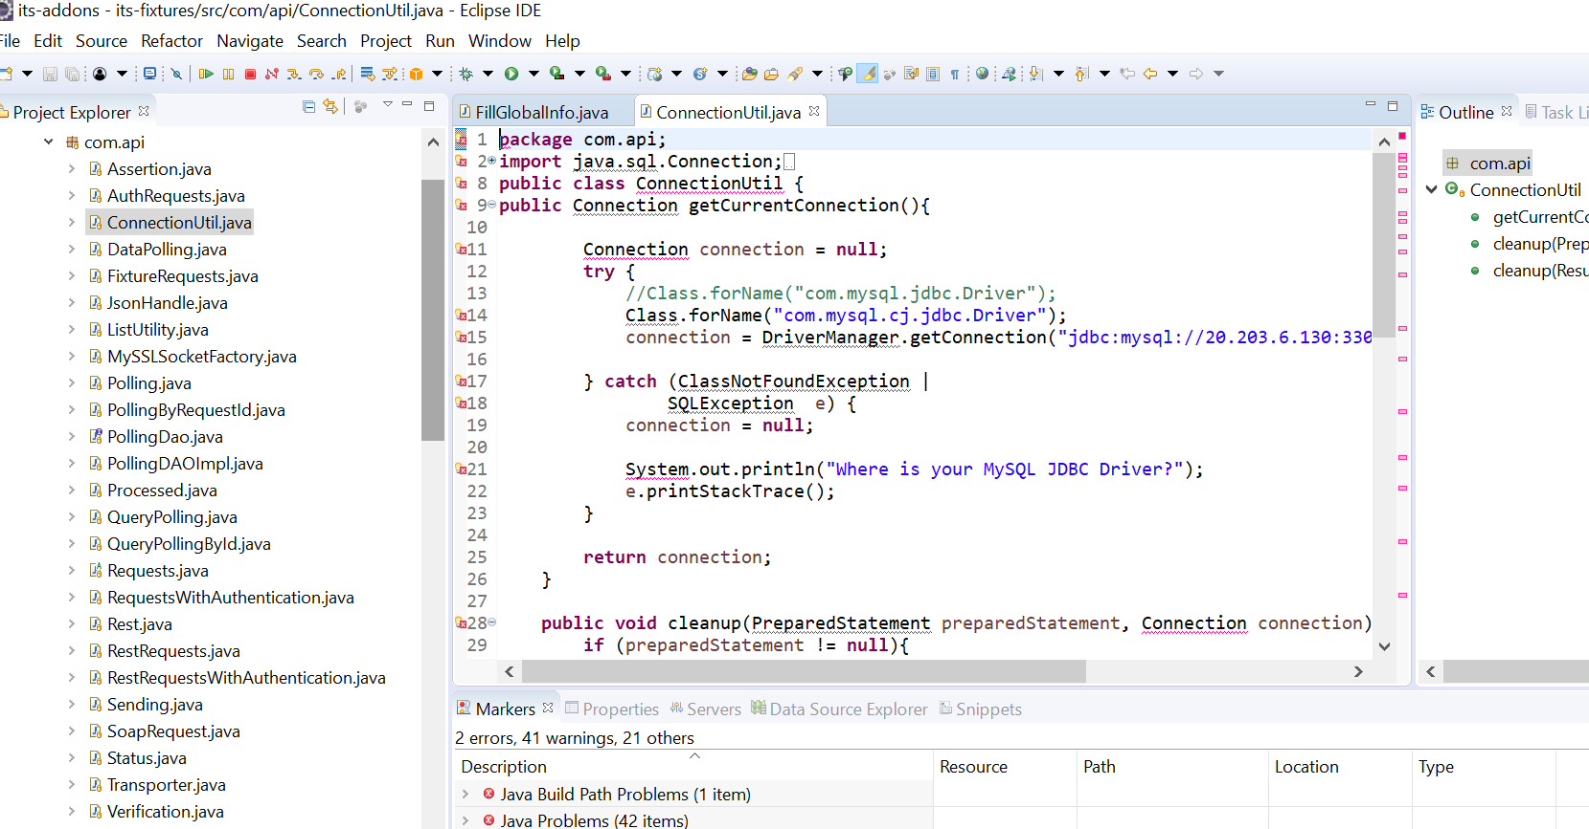
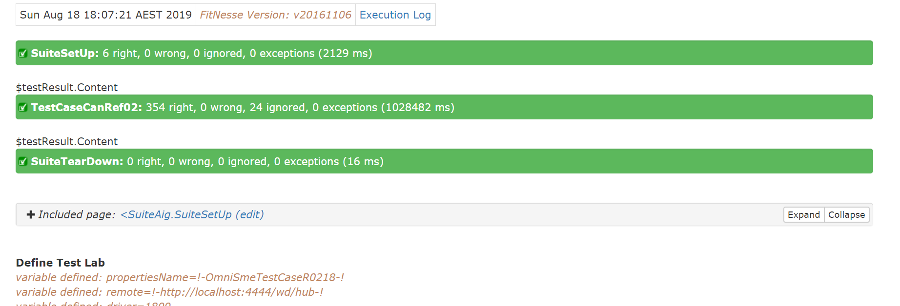
Step 4 executing test and update code until test passes

Slide 66
Step 5 Refactor
Implement the function to filter policy transactions triggering below rules :
Else the status of quotation is Referral Required and the system attached the reason for referral next to the status

Slide 67
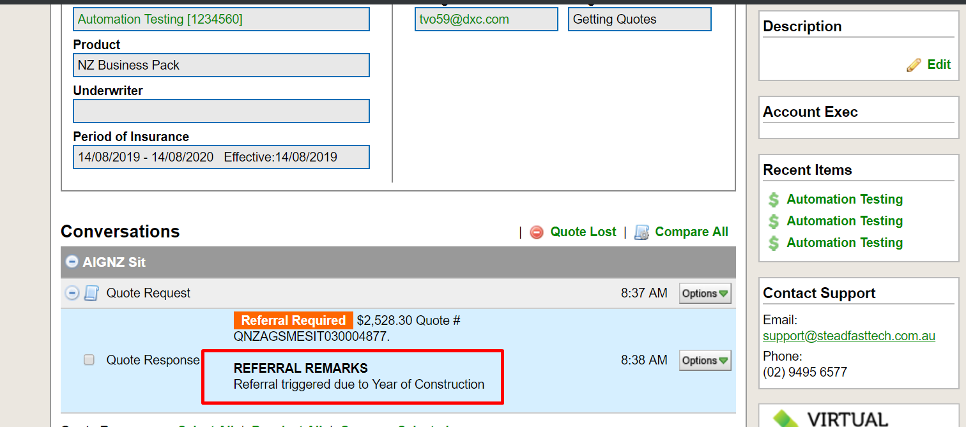
Step 5 Refactor

Slide 68
Question and Answer

Slide 69
Thank you
Contact information
Email: tvo59@dxc.com
Phone: +84 965 912 663
Current location: Cube 63 – Etown 2

Slide 70
Revision History
Date | Version | Description | Updated by | Reviewed and Approved By
03/2019 | 1.0 | Release first version | ThaoNguyen
03/2019 | 1.1 | Update with example for TDD | TuyenLe, ThuyHuynh
03/2019 | 1.2 | Practice TDD with ITS | Dung Tran, ThaoNguyen | Quang Tran, TuyenLe
Notes:
70

